Slide 1
Analysis of the utility of the GRE in UW ChemE Admissions
Elizabeth Nance
*Used by UW ChemE faculty in Autumn 2019 to discuss removal of the GRE requirement

Slide 2
Context: Why are we discussing the GRE?
There is a growing movement to stop requiring GRE for grad admissions¹:
  166 Bio/Biomed Ph.D. programs (including all of the top ones) have dropped GRE requirements or made GRE optional.²
  104 Astronomy Ph.D. programs have dropped GRE requirements
  Computing and Computer Science programs are beginning (MIT, #1; UIUC #5, Cornell #6, Purdue #20)
  UW ECE dropped the GRE as an application requirement with a unanimous faculty vote
Important questions that are being asked:
  Do we use the GRE in our admissions process?
  Is the GRE prohibitive to specific student populations?
  Is the GRE predictive of student success (by any standard metric)?
    Published data
    Our *preliminary* data
Notes:
Add % diversity stats at each round

Slide 3
Published data for STEM PhD students

Slide 4
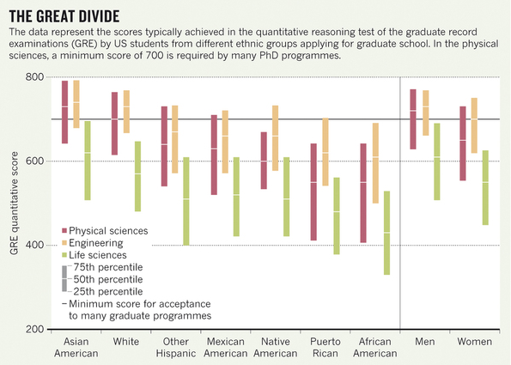
Is the GRE prohibitive to specific student populations?
Short answer: yes
  Growing evidence that the GRE is biased against or at best, inadequately represents abilities of minorities, females, and lower income students.^{3,4,6}
There are significant financial considerations:
  Test prep course: $1000+
  Test cost: $205
    Some students may/need to retake the exam
  Travel to take exam: $ location dependent
  Each score report request past the first four schools listed: $27
    Students are often recommended to apply to 10-15 schools; many apply to more
Notes:
$50 to reschedule or change test taking site

Slide 5
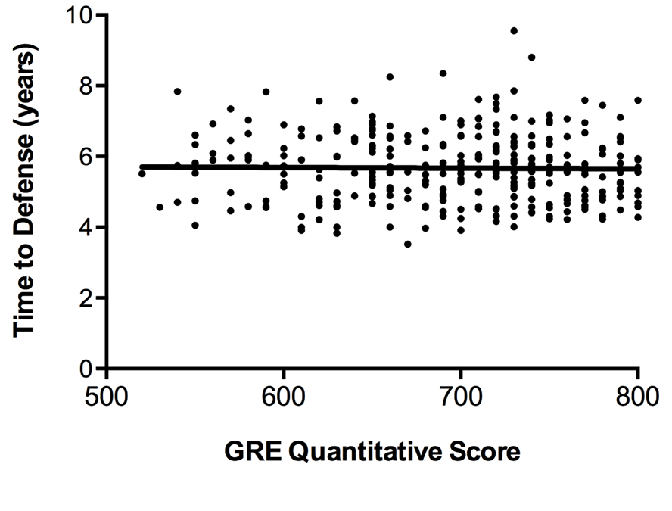
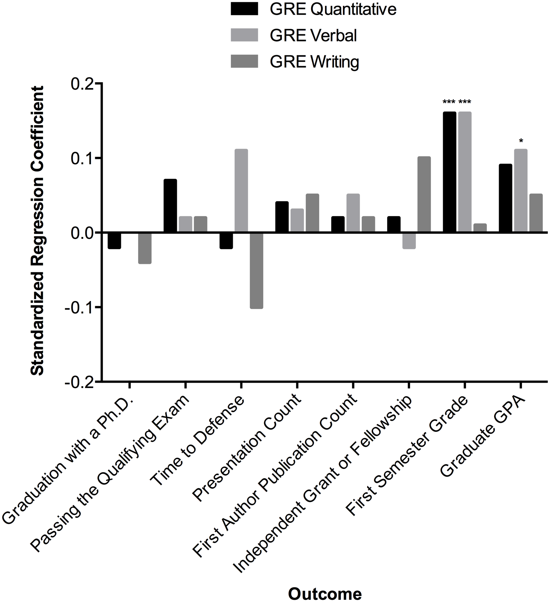
Is the GRE predictive of Ph.D. student success or performance?
Most recent analysis in 2017: data collected for 683 students (2003-2011) in Vanderbilt BME program; analysis included:
  Application info
  Self-reporting after graduation
  Mentor evaluation of student performance after graduation
Applicants with higher GRE scores get better grades in their grad courses.
GRE scores do not predict which students pass their qualifying exams or graduated, or how long they spent in the program.⁵
Moneta-Koehler et al (2017) PLoS One
Notes:
Fig 1. Correlations between GRE Quantitative scores and continuous measures of student progress and productivity.
Scatterplots of GRE Quantitative scores and (A) Time to Defense regression coefficient = 0.00, p = .83, R² = 0.00,
Fig. 2 Standardized regression coefficients reported after controlling for other admissions criteria. Cohort fixed effects are included for each model. Coefficients of zero appear as missing bars. *p < .05. **p < .01. ***p < .001.
Noted limitations of data – only captures students enrolled in the program (not those who did not enroll or weren’t accepted); does not account for PI variability or research area variability (time to publication, presentation could vary)

Slide 6
A more recent study in 2018 showed additional interesting trends…
“Our findings provide strong evidence that GRE scores are not predictive of STEM doctoral degree completion for U.S. and Permanent Resident students.”
“We found that GRE Q scores did not predict PhD completion for women in STEM programs.”
“unexpectedly, GRE Q scores were higher for men who left than for those who completed PhDs.”
  men with GRE scores in the lowest quartile finished at higher rates than any other group, a pattern seen in each of the four institutions.
  men in the lowest quartile had GRE Q percentile scores averaging approximately 34, and those in the highest quartile had percentile scores averaging 91.
“GRE scores did not predict time to degree or foretell who would leave during or after the first year”
Peterson et al (2018) PLOS ONE https://doi.org/10.1371/journal.pone.0206570

Slide 7
UW ChemE MS and PhD data

Slide 8
Is M.S. student performance (grad GPA) correlated to GRE scores?
MS degrees awarded in UW ChemE from A2015 – W2019
Notes:
Verbal and Quantitative significant for International students
Writing significant for Domestic students
None are significant for both domestic and international students

Slide 9
MS GRE score for international students plotted verse grad GPA
General conclusion: no correlation between any GRE score and first year grad GPA for international MS students, and no difference between male and female students

Slide 10
GRE scores for international students plotted verse number of quarters to finish MS degree
General conclusion: no correlation between any GRE score and the number of quarters to complete an MS degree for international MS students

Slide 11
TOEFL scores plotted verse grad GPA and number of quarters to obtain MS degree for MS students
Notes:
No correlation determined between TOEFL and time to graduate or grad GPA for international MS students

Slide 12
Relationship between GRE percentile and grad GPA for PhD students (by gender)
P=0.0212 for Male students in GRE W% and Grad GPA
Notes:
P=0.0212 for Male students in GRE W% and Grad GPA

Slide 13
Relationship between GRE percentile and grad GPA for PhD students (domestic v international)
P=0.0345 for Domestic students in GRE V% and Grad GPA

Slide 14
Relationship between GRE % score and time to PhD degree

Slide 15
Relationship between Grad GPA and time to PhD degree

Slide 16
Relationship between TOEFL score and Grad GPA for PhD students

Slide 17
Data for students who left PhD program
Two female students left because identified PhD was not for them

Slide 18
Current Admissions Process

Slide 19
Notes from other ChemE departments
Caltech ChemE only requires the GRE for international students
UCSB ChemE was going to drop the GRE for this cycle, but is doing a trial run to see how important GRE scores are for them for the international schools to which we aren't well calibrated
  BUT they are still planning to drop the GRE for next admissions cycle
Efforts at Princeton to drop the GRE in ChemE have not gone well

Slide 20
Do we use the GRE in our admissions decision-making process?
Evaluation of PhD applications (current)
GPA & Individual Course Grades – primary metric for first ranking
  Overall student performance (GPA), trends in course grades, grades in specific ChemE-related courses
References – primary metric for second ranking
  Strength of recommendation; factors evaluated by referee, especially research performance; Selection of referees
  Note: this is a place where implicit bias is most prominent⁶
Personal Statement
  Originality: Not cookie-cutter
  Authenticity: Interests and motivations described well and show maturity
  Persuasiveness: Statement makes a compelling case for admission
  Writing style: Logical progression, pacing, grammar, spelling
  Compliance: Within page limit (one page … many were 2 pages, even 3 pages!)

Slide 21
Do we use the GRE in our admissions decision-making process?
Current evaluation of PhD applications near the cut-off
Review personal statement
  Careful reading, re-read as necessary
  Discuss among admissions committee (usually just GPA & GPC at this point)
  Identify possible admits
  Decline all others
Re-balance for primary interest and diversity
Make final selections for admission

Slide 22
Do we use the GRE in our admissions decision-making process?
Evaluation of MS applications (current)
Primary data: ChemE core course grades/GPA
  Get at least >2.7 for each class and >3.0 cumulative GPA
Secondary: Letters of recommendation, personal statement, and resume
Tertiary: TOEFL and GRE scores
  Focus on verbal and writing portions of GRE (anecdotal)

Slide 23
References and Resources

Slide 24
References
Langin K. (2019) Science https://doi.org/10.1126/science.caredit.aay2093
Hall, J. Current list of bio/biomedical graduate programs that dropped, or plan to drop, the GRE: https://docs.google.com/spreadsheets/d/1MYcxZMhf97H5Uxr2Y7XndHn6eEC5oO8XWQi2PU5jLxQ/edit#gid=0
Miller C and Stassum K. (2014) Nature 510, 303-304; https://doi.org/10.1038/nj7504-303a
Miller C et al (2019) Sci Adv, 5(1) eaat7550; https://doi.org/10.1126/sciadv.aat7550
Moneta-Koehler L et al (2017) PLoS ONE 12(1): e0166742. https://doi.org/10.1371/journal.pone.0166742
Moss-Racusin et al (2012) PNAS 109(41), 16474-16479. https://doi.org/10.1073/pnas.1211286109
Peterson et al (2018) PLOS ONE https://doi.org/10.1371/journal.pone.0206570

Slide 25
Additional References
Bell SM, Blumstein J, Brose K, Carroll A, Chang J, Charles J, et al. Defining success in graduate school. Mol Biol Cell. 2014; 25(13): 1942–1944. pmid:24970485
Benderly, B.L. GREs don't predict grad school success. What does? Science, Jun. 7,
2017. http://www.sciencemag.org/careers/2017/06/gres-dont-predict-grad-school-success-what-does
Burton, N. W., and M.-m. Wang. 2005. Predicting Long-term Success in Graduate School: A Collaborative
Validity Study. ETS Research Report Series 2005: i-61. https://www.ets.org/Media/Research/pdf/RR-05-
03.pdf
Educational Testing Service. 2018. GRE: Guide to the Use of Scores, 2018-19. http://www.ets.org/gre/guide
Educational Testing Service. 2017. A Snapshot of Individuals Who Took the GRE General Test.
https://www.ets.org/s/gre/pdf/snapshot_test_taker_data_2017.pdf
Hall, J. D., A. B. O'Connell, and J. G. Cook. 2017. Predictors of Student Productivity in Biomedical Graduate
School Applications. PLoS One 12:
e0169121. http://journals.plos.org/plosone/article?id=10.1371/journal.pone.0169121
Kuncel, NR., Ones, DA and Hezlett, SA. 2001. A comprehensive meta-analysis of the predictive ability of the
GRE: Implications for graduate student selection and performance. Psychological Bulletin 127: 162-181.
https://www.ncbi.nlm.nih.gov/pubmed/11271753
Pacheco WI, Noel RJ, Porter JT, Appleyard CB. Beyond the GRE: Using a Composite Score to Predict the Success of Puerto Rican Students in Biomedical PhD Porgram. CBE Life Sci Educ. 2015; 14: 1–7.
Posselt, J. R. 2014. Toward Inclusive Excellence in Graduate Education: Constructing Merit and Diversity in PhD
Admissions. American Journal of Education 120: 481-514. https://eric.ed.gov/?id=EJ1034780
Posselt, J. R. 2016. Inside Graduate Admissions: Merit, Diversity, and Faculty Gatekeeping. Cambridge: Harvard
University Press. (PDFs of Chapters 1 and 2 available by request to the Graduate Division.)
Weiner, O. 2013. How should we be selecting our graduate students? Mol Biol Cell 25: 429-
430. http://www.molbiolcell.org/content/25/4/429.long
Wilson, Mirenda A., Max A. Odem, Taylor Walters, Anthony L. DePass, and Andrew J. Bean. 2019. A Model for
Holistic Review in Graduate Admissions That Decouples the GRE from Race, Ethnicity, and Gender.
CBE—Life Sciences Education 18:ar7, 1–12. https://www.ncbi.nlm.nih.gov/pubmed/30735085

