Slide 1
University Of Washington
Chemical Engineering Leadership Series
A Midcareer Perspective:
J. Graham Bailey
Paper-machine Manager – Newsprint
Class of 1985

Slide 2
Chemical Engineering – Past, Present and Future Perspective
AGENDA
Why do I love my job? (3-5)
Leadership Philosophy (6)
Who is Weyerhaeuser Company? (7)
What do we do at work? (8-17)
Professional Experience (18-19)
Key Learning (20-21)
Key Decisions (22)
Future Chemical Engineers (23-28)

Slide 3
Reasons I love my job!
Very ethical company who cares for employees
Ability to help others be successful
Ability to contribute to solving diverse problems
Relationships
Team work is fun
World class results
Japanese Culture
Community Minded
Competitive benefits
Notes:
I love my job and I wish you the same. I have found that loving what you do opens doors for you. WY honors commitments.

Slide 4
Key Learning at UW
Chemical Engineering is a great program, making it through is a significant accomplishment
Technical problem solving with a team is rewarding
Mass balances, unit operations, reactor design, thermodynamics, fluid mechanics, heat transfer, surface / colloids, …….. gave me specialized skills and a great foundation to solve problems in industry
Relationships, advisors and mentors are very helpful
Notes:
John Berg

Slide 5
Key Learning’s at UW - Continued
Visualize the microscopic and macroscopic, it will help you solve problems
Where you draw your box is very important
There are times you will need to work really hard and make personal sacrifices to get the job done
Time flies so have fun along the way

Slide 6
Passionate Leadership Philosophy
Teamwork with support makes good things happen!
Safety:
  Many things are outside our control however all injuries are preventable by:
    Controlled work pace
    Appropriate risk assessment including mitigation
Ethics:
  Learn the rules and play by them
  Know and meet all legal requirements
    Environment, safety, employee relations, diversity
  Keep suppliers and competitors at arms length
Notes:
Passion
Significant other Karin Austin (Garrett, 19 and Emmy, 17)
Enjoy snow skiing, motorcycles, hiking, & travelling
Suppliers will wine and dine you for business – this is unethical in WY

Slide 7
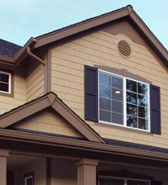
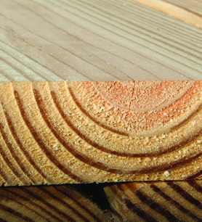

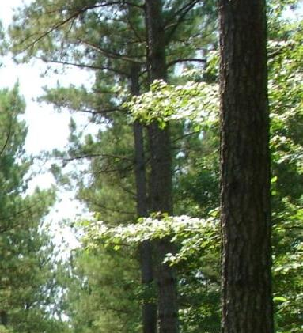
Who is Weyerhaeuser? FOREST PRODUCTS LEADER
FOUNDED: | 1900
2010 REVENUES: | $6.6 Billion
FORTUNE 500 RANK: | 147
NUMBER OF EMPLOYEES: | 15,000 in 10 countries
TECHNOLOGY STAFF: | 300 scientists / engineers
FORESTLAND OWNED OR MANAGED: | 21.6 million acres
HOME OFFICES: | Federal Way, WA
SALES AND SUPPORT: | Worldwide

Slide 8



Where do we work?
2100 TPD Newsprint and high bright paper grade mill -- largest in North America
Joint Venture
  50/50 ownership: Weyerhaeuser (USA)
  Nippon Paper (Japan)
750,000 tons ($500MM Annual Sales)

Slide 9
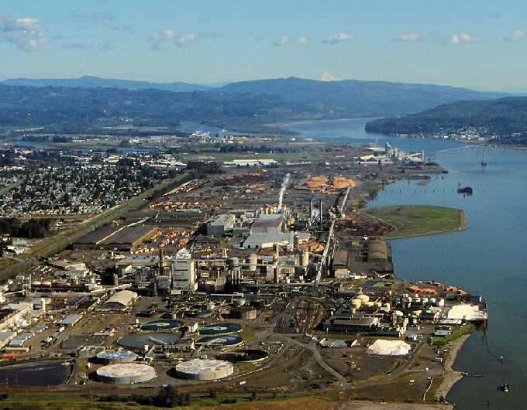
Notes:
The Weyerhaeuser Longview Plant sit is over 1 mile long and includes a saw mill, a bleached paperboard mill and NORPAC.

Slide 10
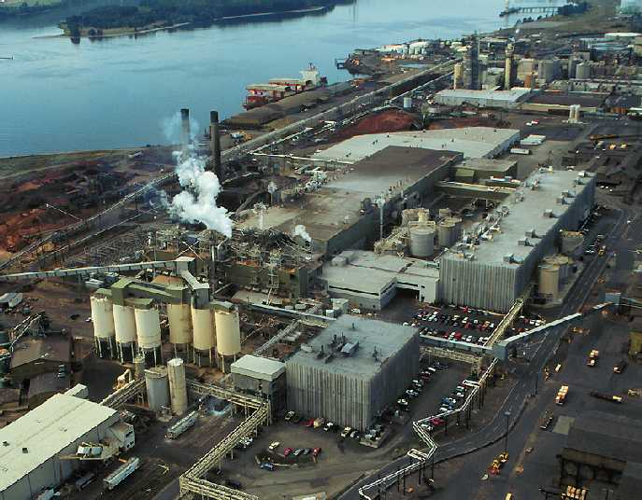
NORPAC Overview
Columbia River
Warehouse
&
Shipping
インタースージスクリーン
#1&2PM
#3PM
TMP
Office
Silos
DIP
North
Pulper
UW Chem. Engr. Leadership Series
Notes:
This shows NORPAC mill operations. Built in 1979. Produces more than 2000 tpd of printing and writing papers for customers in the US and Pacific Rim.

Slide 11


Our Customers (2011 Estimate)
20% Japan
    Yomiuri Shimbun
    Asahi Shimbun
    Magazine Publishers
    - Kodansha
    - Shueisha
    - Shogakukan
6% Non-Japan Asia
75% US
    Gannett
    Dow Jones
    Media News
    Seattle Times
    Book publishers
    Commercial printers

Slide 12
My Peers - Mill Leadership Team
Mill Manager
Assistant
Paper-machine Manager
Pulp-mill
Manager
Warehouse Manager
HR Manager
Accounting Manager
Engineering Manager
Our People
399 Employees
Non-union workforce
24 hour, 365 day operation

Slide 13
Our Team - Papermill Department (83 employees)
Paper machine Manager
Process Manager
A-Crew Leader
15 Operators
B-Crew Leader
15 Operators
C-Crew Leader
15 Operators
D-Crew Leader
15 Operators
Special Project Engineer
Chemical Engineer
Mechanical Engineer
Mech. Leader
10 Mechanics
Elect. Leader
7 Electricians
Quality Manager

Slide 14
Our Facilities:
3 Paper Machines:
    TRIM SPEED
    #1 PM: 1979 356” 4425 FPM
    #2 PM: 1981 356” 4200 FPM
    #3 PM: 1991 330” 4700 FPM
    (approximately 50 MPH)
Pulp Supply:
    TMP Mill 1979 1600 tpd
    Deink Mill 1991 560 tpd
    Kraft (Weyerhaeuser Longview) 125 tpd
Notes:
Three of the world’s largest and fastest paper machines, everyday we make enough newsprint together to produce a 30-foot wide sheet extending from Seattle to Miami
The deink mill consumes 600-700 tons of recycled newspapers every day. This is equivalent to all the newspapers collected daily in Washington, Oregon and Idaho

Slide 15
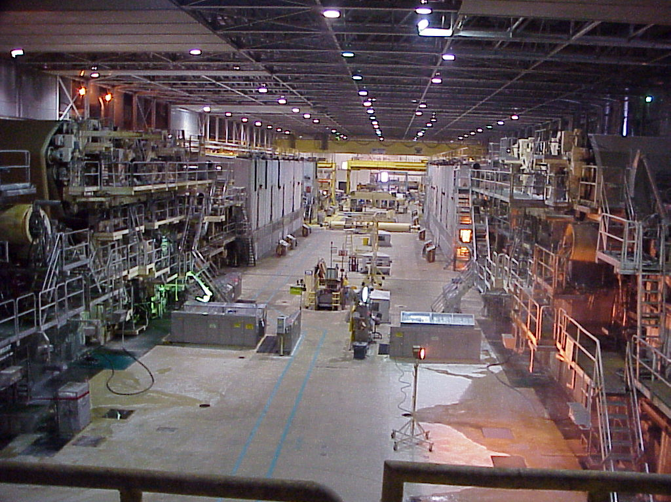
１号マシン １
Notes:
The length of the machine room is over three football fields.

Slide 16
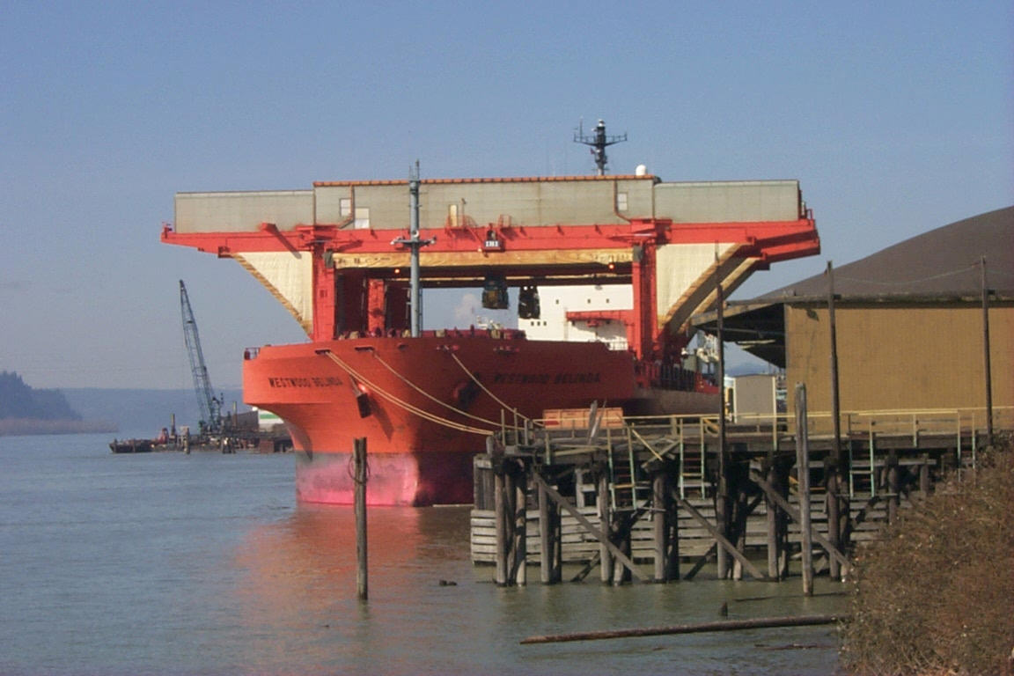
NORPAC - Facilities
Truck, rail, deep-water port shipping facilities all on plant site

Slide 17
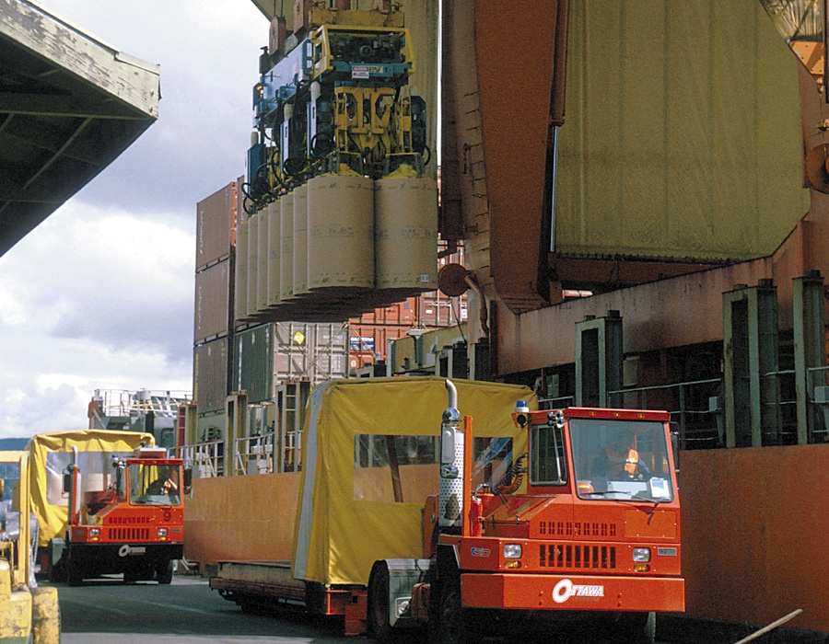
NORPAC

Slide 18
Professional Experience & Education - Weyerhaeuser (27 years)
Technical Intern, Kraft Pulp – Everett, WA (1984)
BS Chem. Engr. – University of Washington (1981 - 1985)
Production Supervisor, Pulp – Rothschild, WI (1985-1986)
Production Supervisor, Fine Paper – Rothschild, WI (1986-1987)
Production Supervisor (Start Up), Fine Paper – PA, SK (1987-1990)
Assistant Production Manager, Fine Paper – Prince Albert, SK (1990-1991)
Start Up Team - #3PM, NORPAC – Longview, WA (1991-1992)
Development Manager, NORPAC – Longview, WA (1992-1997)
Quality Manager, NORPAC – Longview, WA (1997-2005)
MBA – University of Washington (2001-2003)
Production Manager – NORPAC (2005 - 2007)
NORPAC Paper-machine Manager – Longview, WA (2007 – 2011)
NORPAC Pulp mill Manager – Longview, WA 2012 -
Notes:
Progression of a career is important!

Slide 19
Skill Development Time Line
Notes:
Your ability to contribute comes from many different skill sets you bring to the problem. I have attempted to develop a balanced set of skills in the four areas so that I can contribute in more of a general manager position. You may decide to develop your skills in a different way. Maybe you will be heavier in the technical leading to a process design of R&D position or more of the social and business skills leading to technical sales. These are choices you will make along the way.

Slide 20
Key Career Learning Looking Back
Aspire to be great and develop the skills necessary
Have realistic career expectations and be patient, there are only so many promotions to go around
Develop and foster relationships
Maximize your opportunity to learn and grow
Develop a safety and ethics philosophy and stick to it

Slide 21
Key Career Learning Looking Back
Stress is being accountable for things that are out of your control
Experience and knowledge will allow you to influence what you thought was out of your control
Develop a stress management plan with your support group, include exercise
Listen, learn and sleep before you act
Notes:
What does stress mean to you? What kinds of things go into a stress management plan? Balanced Life!

Slide 22
Decision points
What type of leader do you want to be?
  Technical problem solver
  Leader of people
  Profit and Loss Responsibility
Where do you want to live?
Family / Geography / Career - Balance?
Experience is not all created equal
  Five years experience in an ongoing operation verses one year on a start-up
  New technology
  Cross department
Notes:
I have often struggled with the right balance between work, family, social, fun. What does the idea of life balance mean to you?

Slide 23
Future Chemical Engineering at Weyerhaeuser
Develop your own “Safety Philosophy”
Think with a “Global Perspective”
Manufacturing support and development
Selling Engineering ideas to non-technical world
Technology is the engine of prosperity, stay current:
  New process conception and development
  Innovative / creative high return projects
Ability and passion for business value - line of sight

Slide 24
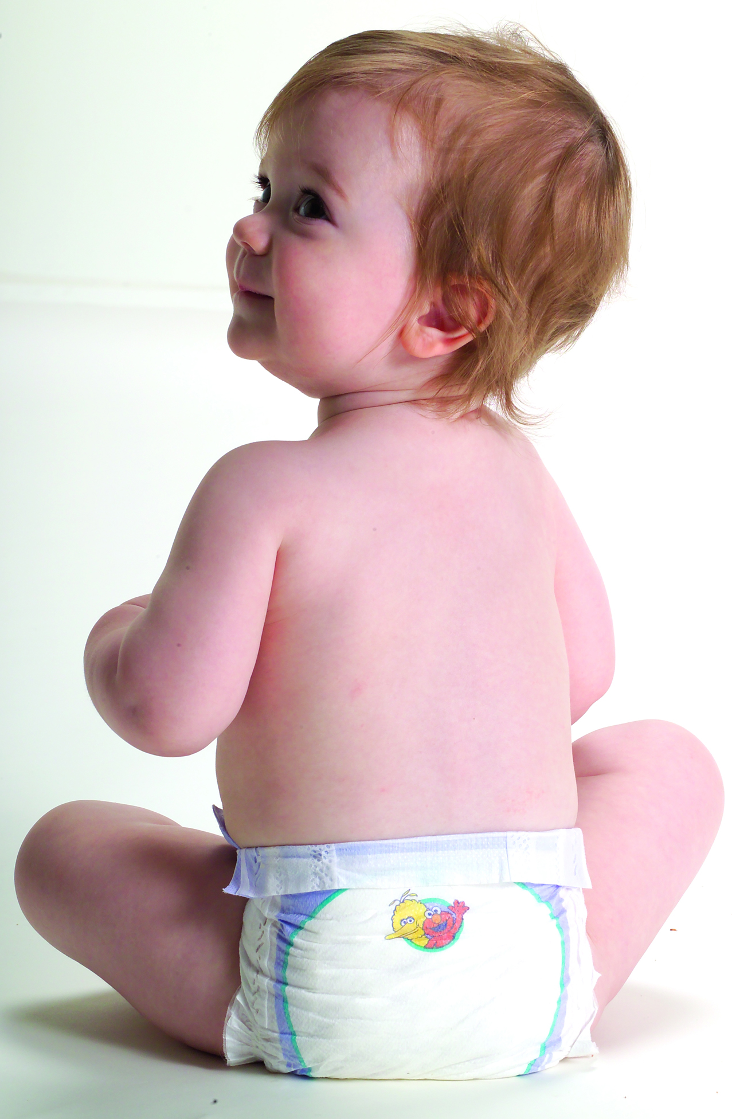

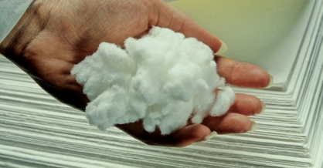
Emerging Global Middle Class
Drive Convenience Products
Chemical Engineering Possibilities for the Future
4,300 diapers per sec in 2010
15,000 by 2015
Cellulose modifications
Notes:
24

Slide 25
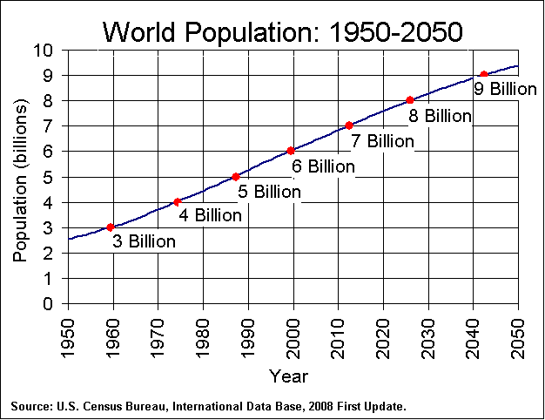

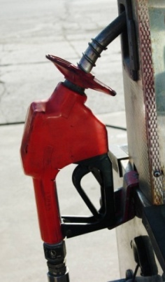
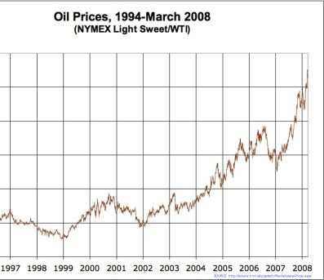

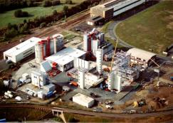
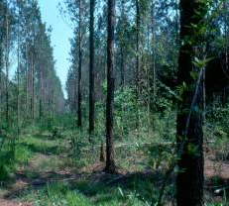
The Next Profitable Uses For Forest Resources?
WHAT’S NEEDED?
WHAT DO WE BRING?
Forestry
Biomass logistics/
handling
Scale processing/
conversion
Sustainable energy and materials that enhance our quality of life

Slide 26
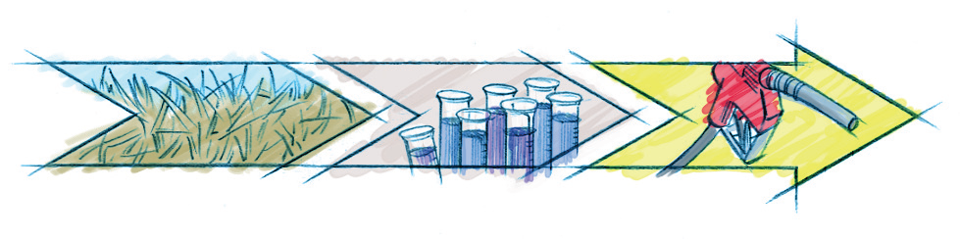
Chemical Engineering Possibilities for the Future
Catchlight Energy Value: Forest to Fuel:
Leverages the strengths of natural resource leaders
Catchlight Energy
Conversion Technology
Weyerhaeuser
Feedstocks
at Scale
Chevron
High Quality Fuel
to Customers
Notes:
Weyerhaeuser has forest residuals and agricultural feedstocks such as switch grass

Slide 27
Tips for finding the job you want:
Internships – do as many as you can
Network – LinkedIn
Use search firms that interview you – avoid resume farms
Key resume characteristics:
  Leave out the soft skills and objectives
  Include interests and hobbies
Study the career paths of others
Only apply for jobs you are qualified for – if more than 3 years experience is needed wait until you have it.

Slide 28
Interviewing tips:
Engineers historically ask close ended questions – answer assuming it was an open ended question
Give examples: Situation, Task, Action, Results
  Point out what you learned, projects are often unsuccessful, tell what you would do different
Always ask questions
Be confident / assertive but not aggressive
Notes:
Chemical Engineering Jobs in the Northwest
High Tech – lots of process piping and equipment
Pulp and Paper
Small / Medium Bio-fuels
Pharmaceuticals
Civil / Environmental Engineering

Slide 29
Summary
Be Safe!
Be Ethical!
Develop your skills!
Balance career, family & fun wisely!
Love your job!

Slide 30

Thank you for the opportunity to speak today and thank you for your attention
What Questions
do you have?
Notes:
Thank you to Dr Berg for inviting me to speak today
Thank you for allowing me the opportunity to reflect a little bit on my time hear at this great university and this time in my life.

